Slide 1
F5 Automation Toolchain
Application Services 3 Extension
Stephen Archer
Specialist Systems Engineer – Cloud & Automation
April 2019

Slide 2
Notes:
Early examples of automation: routing protocols, SNMP polls/traps, telnet/expect scripts.

Slide 3
Automation Concepts

Slide 4
RESTful API
API
noun Computing
a set of functions and procedures that allow the creation of applications which access the features or data of an operating system, application, or other service.
RESTful API
a REST API uses HTTP URIs and Methods (POST, GET, PUT DELETE) to Create, Read, Update, and Delete (CRUD)
GET to obtain /some/resource
POST to modify /some/other/resource
Notes:
Early examples of automation: routing protocols, SNMP polls/traps, telnet/expect scripts.

Slide 5
Non-Idempotent Operations
Multiple identical requests can produce errors…
Empty Configuration
50x ERROR
Object already exists
Create Object A
Object A
Create Object A

Slide 6
Idempotent Operations
Multiple identical requests have the same effect as making a single request…
Empty Configuration
200 Success.
No change.
Create Object A
Object A
Create Object A

Slide 7
Atomic Transactions
Partially Committed
Committed
Begin
Preparing
Roll-Back
End
Failed
Aborted

Slide 8
Imperative Operations
Domain specific knowledge required to deploy a…
Virtual
Server
HTTP Profile
SNAT Profile
Pool
Monitor
Client TCP Profile
Server TCP Profile
Node
Client SSL Profile
Certs
Server SSL Profile
Node
Key
Node

Slide 9
Declarative Operations
Easy to deploy…
Virtual
Server
You worry about this stuff… I don’t care. Just give me a Virtual Server.

Slide 10
App Services 3 Extension

Slide 11
F5 Automation Toolchain
Deploy
App Services
Monitoring /
Telemetry
Bootstrap
Onboard
CLOUD TEMPLATES
Start BIG-IP instances in Public & Private Clouds
Available Now
DECLARATIVE ONBOARDING EXTENSION
Initial Config of BIG-IP instances
Available Now
APP SERVICES 3 EXTENSION
Deploy Application Services on BIG-IP using declarative APIs
Available Now
TELEMETRY STREAMING EXTENSION
Stream Events & Logs from BIG-IP to various Analytics and Logging solutions.
Available now
Notes:
Imperative: HOW to reach a desired end-state
Step-by-step specific & ordered instructions
Requires domain-specific knowledge
Maximizes flexibility at the cost of extra complexity
Infinite deployment options
Not reusable in many cases
Usually not idempotent
Attractive to NetOps
Declarative: WHAT the end state needs to be
Single step instruction
Minimizes need for domain-specific knowledge
Reduced flexibility and reduced complexity
Finite packaged deployment options
JSON document approach enables reusability
Easier to make idempotent
Attractive to DevOps
AS3:
Abstracts away all aspects of BIG-IP L4-L7 configuration
Eliminates need for BIG-IP domain expertise
Speeds BIG-IP app service deployments
Reduces risks and errors
Enables consistency via easy deployment replication
Reduces integration coding costs
Spend more time writing apps, not integrations

Slide 12
What is the App Services 3 Extension (AS3)?
TMOS independent RPM package installed on BIG-IP*
Provides a single declarative REST API endpoint…
https://big-ip/mgmt/shared/appsvcs/declare
Interface for common L4-7 app service use cases
Atomic and idempotent
Multi-tenant
Accepts a single JSON document
Omitted values assume defaults
Guaranteed to be backward compatible
Requires TMOS 12.1+
Available now: https://github.com/F5Networks/f5-appsvcs-extension
Free & supported by F5

Slide 13
What can and can’t you do with AS3?
LTM 75% coverage
ASM – apply existing policy (can be downloaded from repo)
APM - apply existing policy (can be downloaded from repo)
AFM -
DNS -

Slide 14
Automation Toolchain Within Customer Ecosystem
Management & Ecosystem Solutions
Source of Truth
Declarative - Tell the system WHAT you would like to happen and let it figure out HOW to do it
F5 Automation Toolchain (Declarative API)
Imperative - Tell the system HOW to do something and as a result WHAT you want to happen
F5 iControl REST (Imperative API)
Notes:
Imperative: HOW to reach a desired end-state
Step-by-step specific & ordered instructions
Requires domain-specific knowledge
Maximizes flexibility at the cost of extra complexity
Infinite deployment options
Not reusable in many cases
Usually not idempotent
Attractive to NetOps
Declarative: WHAT the end state needs to be
Single step instruction
Minimizes need for domain-specific knowledge
Reduced flexibility and reduced complexity
Finite packaged deployment options
JSON document approach enables reusability
Easier to make idempotent
Attractive to DevOps
AS3:
Abstracts away all aspects of BIG-IP L4-L7 configuration
Eliminates need for BIG-IP domain expertise
Speeds BIG-IP app service deployments
Reduces risks and errors
Enables consistency via easy deployment replication
Reduces integration coding costs
Spend more time writing apps, not integrations

Slide 15
Automation Without AS3
Multiple Imperative Commands
Management &
Ecosystem Solutions
F5 BIG-IP
iControl REST (Imperative API)
Notes:
Requires BIG-IP domain expertise
Dozens of REST API calls
Costly to automate and integrate with orchestration systems
Time-consuming
Error-prone

Slide 16
Automation With AS3
Single Declarative Statement
Multiple Imperative Commands
Management &
Ecosystem Solutions
F5 Automation Toolchain (Declarative API)
F5 BIG-IP
iControl REST (Imperative API)
Notes:
AS3 abstracts away all BIG-IP configuration complexity
User only needs to define the desired configuration end-state
Requires no BIG-IP domain expertise
Single REST API call simplifies automation and orchestrator integrations
Accelerates app service deployment
Declaration is reusable, ensures consistency, reduces errors

Slide 17





AS3 Everywhere – Consistent API
AS3
AS3
AS3
AS3
AS3
BIG-IP Platform
BIG-IP
Virtual Edition
BIG-IP Platform
BIG-IP
Virtual Edition
BIG-IP SSG
Summer 2018
Autumn 2018
Q1 2019
On BIG-IP
In Cloud w/Service Discovery
In Container
On BIG-IQ

Slide 18
Telemetry Streaming

Slide 19


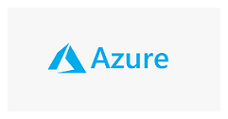






Telemetry Streaming
AS3 consistent configuration in.
Telemetry streaming consistent data out
(Operational & Security)

Slide 20
Automation Workflow Examples

Slide 21

Workflow Example 0.1
Learning about declarative onboarding and AS3 automation of BIG-IP.
REST API Calls
Collections
Physical Appliance / Chassis
Runner
Virtual Edition
Automated Tests
Cloud Edition / Blue
API Dev Tool
TF5 Platform
BIG-IP
+ AS3 + DO
Notes:
DO FAQ (internal): https://hive.f5.com/docs/DOC-49381
AS3 Docs: https://clouddocs.f5.com/products/extensions/f5-appsvcs-extension/latest/
Intro to A&O Lab Guide: https://clouddocs.f5.com/training/community/programmability/html/class1/class1.html

Slide 22
Workflow Example 0.2
AS3 deployment via the BIG-IQ AS3 proxy to leverage BIG-IQ Analytics.
REST API Calls
HTTP Simple
Collections
HTTPS Advanced
Physical Appliance / Chassis
Runner
Application Security
Virtual Edition
Automated Tests
Analytics
Cloud Edition / Blue
API Dev Tool
App Services
TF5 Platform
BIG-IQ
+ AS3
BIG-IP
+ AS3 + DO

Slide 23

Workflow Example 1
Configuration Management using Ansible Tower
Deployment Playbooks
Input Forms (Survey)
HTTP Simple
RBAC
HTTPS Advanced
Physical Appliance / Chassis
Job Scheduling
Application Security
Virtual Edition
Logging & Reporting
Analytics
Cloud Edition / Blue
Orchestration
App Services
TF5 Platform
BIG-IQ
+ AS3
BIG-IP
+ AS3 + DO

Slide 24
Workflow Example 2
Infrastructure as Code using a Source Code Management tool
Deployment Playbooks
Input Forms (Survey)
HTTP Simple
Source Code Repo - IaC
RBAC
HTTPS Advanced
Physical Appliance / Chassis
Revision Control
Job Scheduling
Application Security
Virtual Edition
Webhook
Logging & Reporting
Analytics
Cloud Edition / Blue
SCM
Orchestration
App Services
TF5 Platform
BIG-IQ
+ AS3
BIG-IP
+ AS3 + DO

Slide 25
Workflow Example 3
Self-service provisioning via a service catalogue.
Deployment Playbooks
Input Forms (Survey)
HTTP Simple
Request Form
Source Code Repo - IaC
RBAC
HTTPS Advanced
Physical Appliance / Chassis
Workflow Approvals
Revision Control
Job Scheduling
Application Security
Virtual Edition
Create Config
Webhook
Logging & Reporting
Analytics
Cloud Edition / Blue
Service Catalogue
SCM
Orchestration
App Services
TF5 Platform
BIG-IQ
+ AS3
BIG-IP
+ AS3 + DO

Slide 26
Workflow Example 4
Automated staging and testing before deploying to production
Deployment Playbooks
Physical Appliance / Chassis
Input Forms (Survey)
HTTP Simple
Virtual Edition
Request Form
Source Code Repo - IaC
RBAC
HTTPS Advanced
Cloud Edition / Blue
Workflow Approvals
Revision Control
Job Scheduling
Application Security
TF5 Platform
Create Config
Webhook
Logging & Reporting
Analytics
Service Catalogue
SCM
App Services
BIG-IP + AS3
(DEV)
Orchestration
BIG-IQ
+ AS3
BIG-IP + AS3
(UAT)
BIG-IP + AS3
(PROD)

Slide 27


Workflow Example 5
DevOps CI/CD pipeline integration
Deployment Playbooks
Physical Appliance / Chassis
Input Forms (Survey)
HTTP Simple
Virtual Edition
Request Form
Source Code Repo - IaC
RBAC
HTTPS Advanced
Cloud Edition / Blue
Workflow Approvals
Revision Control
Job Scheduling
Application Security
TF5 Platform
Create Config
Webhook
Logging & Reporting
Analytics
Service Catalogue
SCM
App Services
BIG-IP + AS3
(DEV)
Orchestration
BIG-IQ
+ AS3
BIG-IP + AS3
(UAT)
BIG-IP + AS3
(PROD)

Slide 28
Automation & Orchestration Plan
L1-L3
L4-L7
No
Automation
MGMT
More Complex
Higher TCO
WebUI / CLI
iApps
BIG-IQ
Controller
F5 Portal
Templates
Application
Architecture
Service Scaling
AS3
Declarative Onboarding
Container Services
CY19
Automation Ecosystem (e.g SNOW)
Full
Automation
Less Complex /
Cloud Native
BIG-IP
HW
BIG-IP
VE
Cloud Edition
Cloud Native App Services
F5aaS
0% ~10%
100%
Applications

Slide 29
AS3 Declaration

Slide 30
AS3 Methods
The AS3 API supports Create, Read, Update, and Delete (CRUD) actions…
Remove data for one or more tenants.
If no tenant specified, the entire AS3 configuration is removed.
DELETE
POST
Deploy a configuration:
deploy
dry-run
patch
redeploy
retrieve
remove
GET
Modify existing declaration:
add
remove
replace
move
copy
Retrieve previous declaration.
Select the data you want by appending to the AS3 path.
PATCH

Slide 31
AS3 JSON Schema
The simplest representation of an AS3 declaration…
AS3 Class
Controls AS3 execution
ADC Class
Controls ADC-Centric Attributes
Tenant Class
Tenant
Maps to BIG-IP Partitions
Application Class
Application
Application
Maps to BIG-IP Folders in Partition
Service Class
Service
Maps to BIG-IP Virtual Servers
Service
Service
Pool Class
iRule Class
HTTP_Profile Class
Map to BIG-IP Objects
Pool
Pool

Slide 32
AS3 Sample Declaration
{
"class": "AS3",
"action": "deploy",
"persist": true,
"declaration": {
"class": "ADC",
"schemaVersion": "3.0.0",
"id": "example-declaration-01",
"label": "Sample 1",
"remark": "Simple HTTP application with round robin pool",
"updateMode": "selective",
"Sample_01": {
"class": "Tenant",
"defaultRouteDomain": 0,
"Application_1": {
"class": "Application",
"template": "http",
"serviceMain": {
"class": "Service_HTTP",
"virtualAddresses": [
"10.0.1.10"
],
"pool": "web_pool"
},
"web_pool": {
"class": "Pool",
"monitors": [
"http"
],
"members": [
{
"servicePort": 80,
"serverAddresses": [
"192.0.1.10",
"192.0.1.11"
]
}
]
}
}
}
}
}
Create a simple HTTP application service:
HTTP Virtual Server
Pool named web_pool with 2 members
Monitored by default HTTP health monitor
Partition (tenant) named Sample_01
Declaration not ordered, nor sequenced
POST this JSON text to AS3 at:
/mgmt/shared/appsvcs/declare
That’s it!

Slide 33
AS3 Sample Declaration
{
"firewallPolicy": {
"class": "Firewall_Policy",
"remark": "A firewall policy",
"rules": [{
"use": "ruleList"
}]
},
"ruleList": {
"class": "Firewall_Rule_List",
"remark": "A firewall rule list",
"rules": [{
"name": "rule",
"remark": "A firewall rule list rule",
"action": "drop",
"protocol": "tcp",
"source": {
"addressLists": [{
"use": "addressList"
}]
},
"loggingEnabled": true
}]
},
"addressList": {
"class": "Firewall_Address_List",
"remark": "A firewall address list",
"addresses": [{
"servicePort": 80,
"addressDiscovery": "aws",
"updateInterval": 10,
"tagKey": "application",
"tagValue": "prod",
"addressRealm": "private",
"region": "ap-southeast-2",
"accessKeyId": ”XxXxX",
"secretAccessKey": ”XxXxX",
"credentialUpdate": false
}]
}
}
Add entries to a firewall rule based on AWS tags.
Instance tags.
Added and removed automatically
Declaration not ordered, nor sequenced
POST this JSON text to AS3 at:
/mgmt/shared/appsvcs/declare
That’s it!

Slide 34
AS3 Sample Declaration
{
"class": "AS3",
"action": "deploy",
"persist": true,
"declaration": {
"class": "ADC",
"schemaVersion": "3.0.0",
"id": "example-declaration-01",
"label": "Sample 1",
"remark": "Simple HTTP application with round robin pool",
"updateMode": "selective",
"Sample_01": {
"class": "Tenant",
"defaultRouteDomain": 0,
"Application_1": {
"class": "Application",
"template": "http",
"serviceMain": {
"class": "Service_HTTP",
"virtualAddresses": [
"10.0.1.10"
],
"pool": "web_pool"
},
"web_pool": {
"class": "Pool",
"monitors": [
"http"
],
"members": [
{
"servicePort": 80,
"serverAddresses": [
"192.0.1.10",
"192.0.1.11"
]
}
]
}
}
}
}
}
The AS3 Class
class: AS3 # mandatory
action: deploy, dry-run, redeploy, retrieve, remove
persist: true, false
The ADC Class
class : ADC # mandatory
schemaVersion: 3.0.0, 3.1.0, 3.2.0
Id: arbitrary (suggest using urn::uuid)
Label: arbitrary (labels the declaration)
updateMode: complete, selective
IMPORTANT
This will remove all tenants that AS3 has created
…and replace with this declaration.
The Tenant Class
Sample_01: Tenant name i.e. BIG-IP partition name
class: Tenant # mandatory
defaultRouteDomain: number

Slide 35
AS3 Sample Declaration
{
"class": "AS3",
"action": "deploy",
"persist": true,
"declaration": {
"class": "ADC",
"schemaVersion": "3.0.0",
"id": "example-declaration-01",
"label": "Sample 1",
"remark": "Simple HTTP application with round robin pool",
"updateMode": "selective",
"Sample_01": {
"class": "Tenant",
"defaultRouteDomain": 0,
"A1": {
"class": "Application",
"template": "http",
"serviceMain": {
"class": "Service_HTTP",
"virtualAddresses": [
"10.0.1.10"
],
"pool": "web_pool"
},
"web_pool": {
"class": "Pool",
"monitors": [
"http"
],
"members": [
{
"servicePort": 80,
"serverAddresses": [
"192.0.1.10",
"192.0.1.11"
]
}
]
}
}
}
}
}
Generic: Doesn’t enforce required objects.
Allows you to rename serviceMain
Shared: Holds objects other applications can use
Aside from ‘generic’ and ‘shared’, values for template and virtualAddresses must correlate.
The Application Class
A1: The application name = TMSH folder in partition.
class: Application # mandatory
template: http, https, tcp, udp, l4, generic, shared
The Service Class
class: Service_HTTP, Service_HTTPS,
Service_TCP, Service_UDP, Service_L4,
generic, shared
virtualAddresses: IP Address
The Pool Class
web_pool: Defines the name of the pool
class: pool # mandatory
monitors: not mandatory, but highly recommended!
members: servicePort, serverAddresses # if serviePort
is not included, it will choose a default
related to the template e.g. http = 80

Slide 36
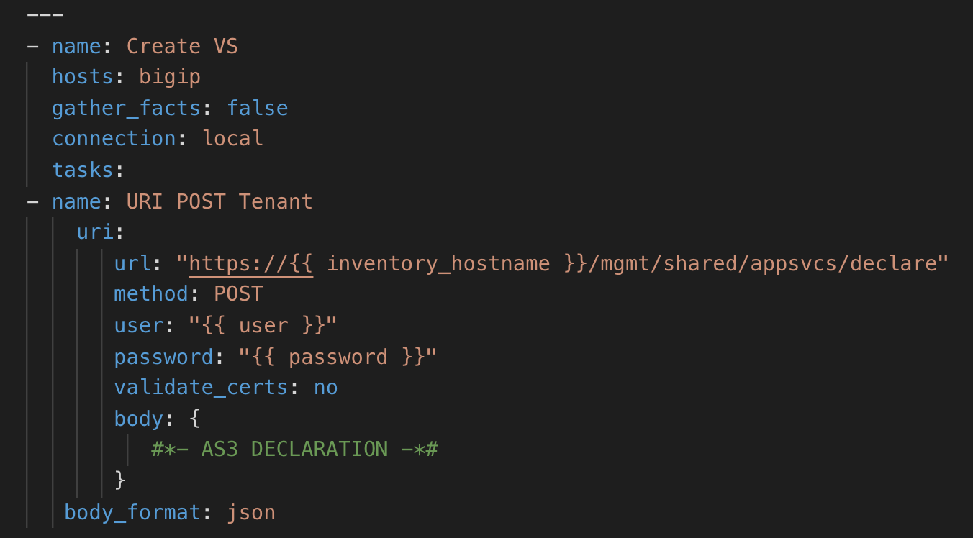
AS3 Sample Ansible Playbook
AS3 Sample Ansible Playbook

Slide 37
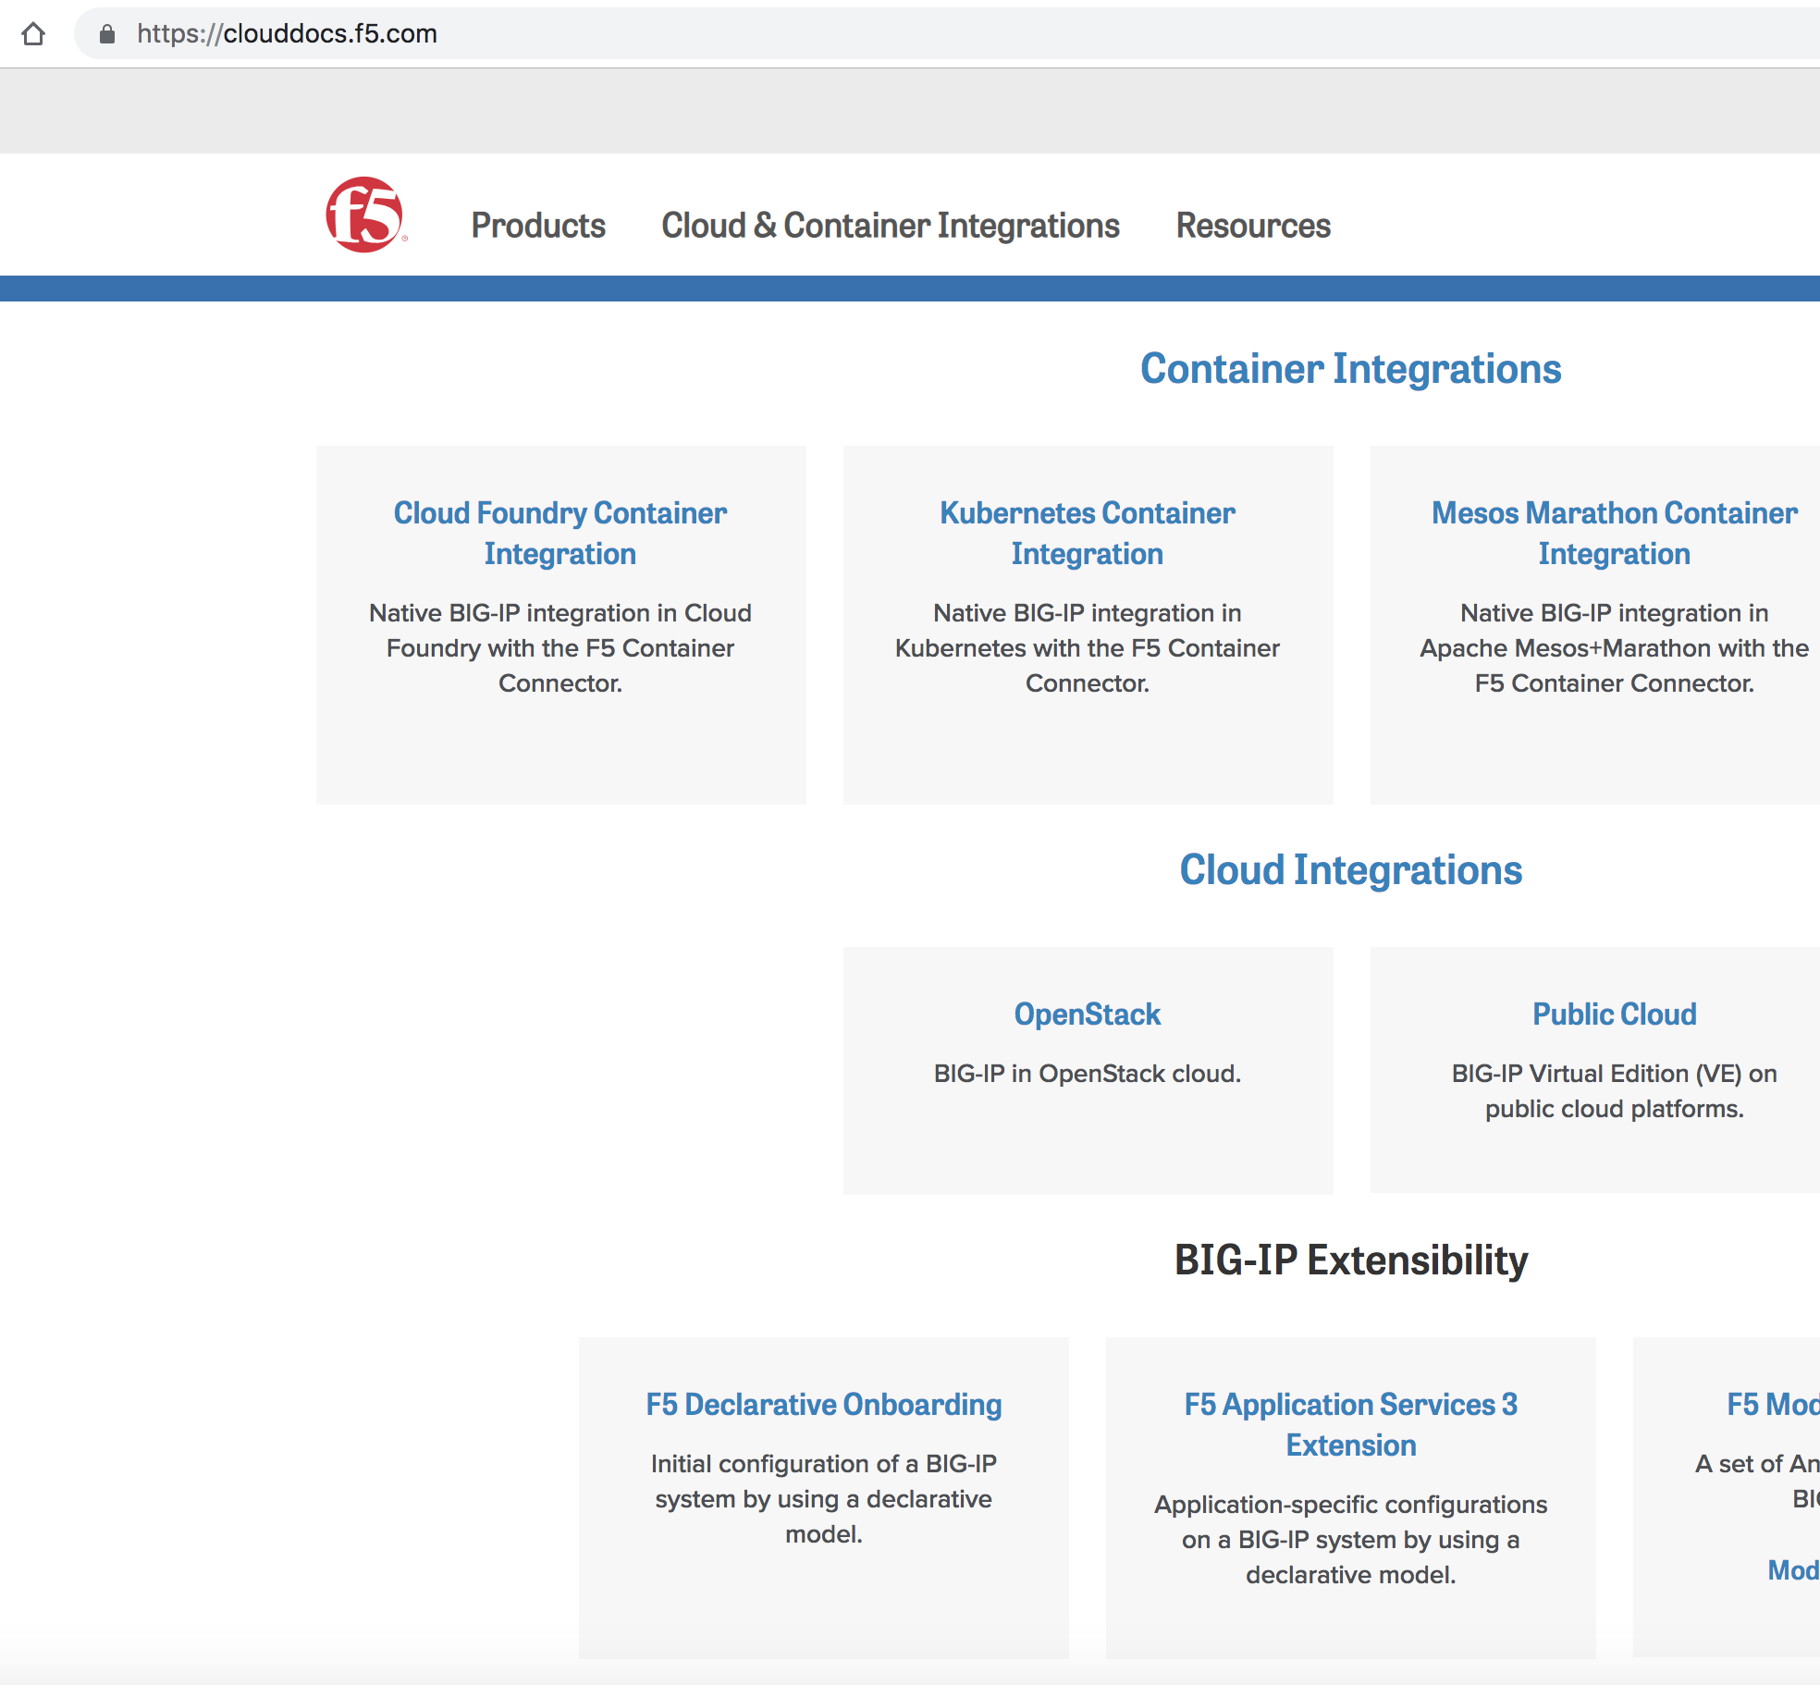
AS3 Documentation
https://clouddocs.f5.com

Slide 38

F5 Super-NetOps Training
https://f5.com/education/super-netops-training

Slide 39
Notes:
Early examples of automation: routing protocols, SNMP polls/traps, telnet/expect scripts.

Slide 40
Demo

